Slide 1

2022-2023
Second Interim Budget
Regular Board Meeting
March 15, 2023

Slide 2
Presentation
Vision & Mission in the Budget Process
First Interim vs. Second Interim
  Revenue and Expenditure Variances
General Fund Summary
  Revenues and Expenditures
Multi-Year Projection
Looking Ahead

Slide 3

Vision and Mission in the Budget Process
Notes:
*Image: Carmel Del Mar Students

Slide 4
Vision and Mission
Vision: Unrelenting pursuit of the extraordinary school experience
Mission: To ignite genius and empower students to advance the world

Slide 5
Budget Process
Budget determinations have been made in accordance with the goals of District Design 2022 and the Local Control Accountability Plan (LCAP)
Maintain a fiscally sound reserve balance for a community funded school district (Basic Aid) and a continued commitment to proactive fiscal planning
Communicate the budget to all stakeholders

Slide 6

First Interim vs. Second Interim
Notes:
*Image: Del Mar Hills Students

Slide 7
Revenue
 | First Interim | Budget Adjustments | Second Interim
LCFF Sources | 59,839,413 | 24,544 | 59,863,957
Federal Revenues | 1,039,985 | - | 1,039,985
Other State Revenues | 11,730,963 | - | 11,730,963
Other Local Revenues | 4,757,231 | 32,762 | 4,789,993
Transfers In | 1,050,000 | - | 1,050,000
Total Revenues | 78,417,592 | 57,306 | 78,474,898

Slide 8
Revenue Variances
LCFF Sources:
  Charter School in Lieu of Property Tax
Other Local Revenues:
  School site donations budgeted when received

Slide 9
Expenditures
 | First Interim | Budget Adjustments | Second Interim
Certificated Salaries | 32,177,386 | 130,000 | 32,307,386
Classified Salaries | 9,316,539 | - | 9,316,539
Employee Benefits | 19,056,698 | - | 19,056,698
Books & Supplies | 3,152,537 | 1,799,971 | 4,952,508
Operating Expenses | 8,093,112 | 29,027 | 8,122,139
Capital Outlay | 206,598 | - | 206,598
Other Outgo/ Transfer Out | 1,358,112 | - | 1,358,112
Total Expenditures | 73,360,982 | 1,958,998 | 75,319,980

Slide 10
Expenditure Variance
Salaries and Employee Benefits:
  Based upon salary expenditures through January 31, 2023
Books, Supplies & Operating Expenses:
  Arts, Music, and Instructional Materials Block Grant
Operating Expenses:
  School site donation expenditures through January 31, 2023

Slide 11
Ending Fund Balance
 | Second Interim
Beginning Fund Balance | 19,705,680
Net Increase (Decrease) | 3,154,918
Ending Fund Balance | 22,860,598
Components of Ending Fund Balance:
Revolving Cash | 25,000
Restricted: | 4,396,008
Assigned:
Minimum Reserve 15% | 11,297,995
Digital Records Solutions | 250,000
3% Reserve for Economic Uncertainties | 2,259,599
Unassigned/Unappropriated | 4,631,996
Unrestricted Reserve Percentage: | 24.5%

Slide 12
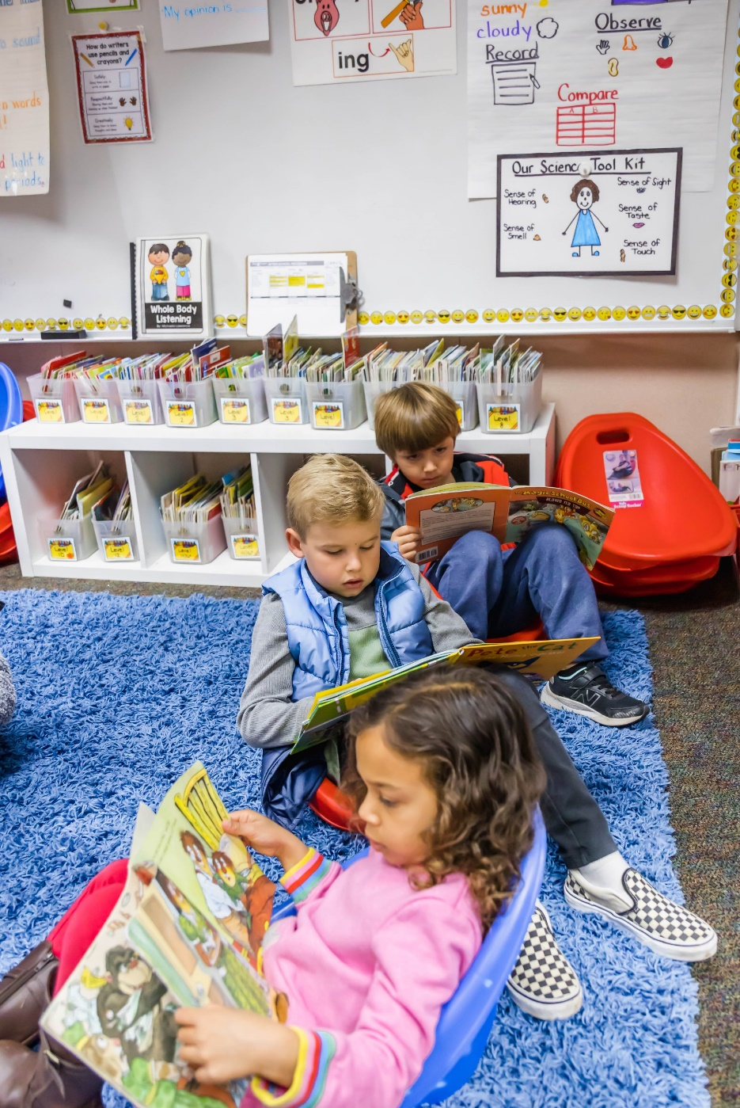
General Fund
Summary
Notes:
*Image: Sage Canyon Students

Slide 13
2022-2023 Revenue Summary
LCFF Sources | 59,863,957
Federal Revenues | 1,039,985
Other State Revenues* | 11,730,963
Other Local Revenues | 3,457,231
DMSEF & Site Donations | 1,332,762
Transfers In | 1,050,000
Total Revenue & Other Financing Sources | 78,474,898
*Other State Revenues includes STRS “on-behalf” contribution of $4,116,526

Slide 14
2022-2023 Expenditure Summary
Certificated Salaries | 28,858,136
Classified Salaries | 8,241,959
Certificated Management | 3,449,250
Classified Management | 1,074,580
Employee Benefits | 6,494,978
Pension Costs* | 12,561,720
Books & Supplies | 4,952,508
Operating Expenses | 8,122,139
Capital Outlay | 206,598
Other Outgo/Transfer Out | 1,358,112
Total Expenditures & Other Outgo | 75,319,980
Total Salary and Benefits = 83.5%
*Pension costs include State STRS “on-behalf” contribution of $4,116,526

Slide 15

Multi-Year Projection
Notes:
*Image: Del Mar Heights Students

Slide 16
Multi-Year Projection
Based upon the School Services of California Dartboard
Property Tax Projection:
  2022-23 3.0% Increase
  2023-24 3.0% Increase
Average Daily Attendance Projections:
  2022-23 3,933
  2023-24 3,812
Salary: Step and Column 2% Increase Annually
Benefits: Annual Adjustments in Employer STRS and PERS Contributions

Slide 17
Multi-Year Projection
DESCRIPTION | FY 2022-23 | FY 2023-24 | FY 2024-25
 | Current (Base Year) | First Projected Year | Second Projected Year
Revenues
LCFF Sources | 59,863,957 | 61,574,767 | 63,374,634
Federal Revenues | 1,039,985 | 990,666 | 990,666
Other State Revenues | 11,730,963 | 7,538,834 | 7,538,834
Other Local Revenues | 4,789,993 | 4,695,247 | 4,696,623
Transfers In/Other Sources | 1,050,000 | 0 | 0
Total Revenues: | 78,474,898 | 74,799,514 | 76,600,757
Expenditures
Certificated Salaries | 32,307,386 | 33,323,901 | 33,990,379
Classified Salaries | 9,316,539 | 9,526,370 | 9,904,397
Employee Benefits | 19,056,698 | 19,446,686 | 19,847,709
Books & Supplies | 4,952,508 | 2,381,295 | 2,483,258
Services, Other Operating Expense | 8,122,139 | 8,063,380 | 8,058,965
Capital Outlay | 206,598 | 313,705 | 422,395
Other Outgo/Transfer Out | 1,358,112 | 559,327 | 560,338
Total Expenditures: | 75,319,980 | 73,614,664 | 75,267,441

Slide 18
Multi-Year Projection
DESCRIPTION | FY 2022-23 | FY 2023-24 | FY 2024-25
 | Current (Base Year) | First Projected Year | Second Projected Year
Beginning Balance as of July 1 | 19,705,680 | 22,860,598 | 24,045,448
Net Increase (Decrease) In Fund Balance | 3,154,918 | 1,184,850 | 1,333,316
Ending Balance | 22,860,598 | 24,045,448 | 25,378,764
Revolving Cash | 25,000 | 25,000 | 25,000
Restricted | 4,396,008 | 4,068,639 | 3,394,196
Assignments:
- Minimum Reserve 15% | 11,297,995 | 11,042,200 | 11,290,116
- Digital Records Solutions | 250,000 | 250,000 | 250,000
Reserve for Economic Uncertainties | 2,259,599 | 2,208,440 | 2,258,023
Unassigned/Unappropriated Amount | 4,631,996 | 6,451,169 | 8,161,429
Total Unrestricted Fund Balance | 18,464,590 | 19,976,809 | 21,984,568
Unrestricted Reserve Percentage | 24.5% | 27.1% | 29.2%

Slide 19
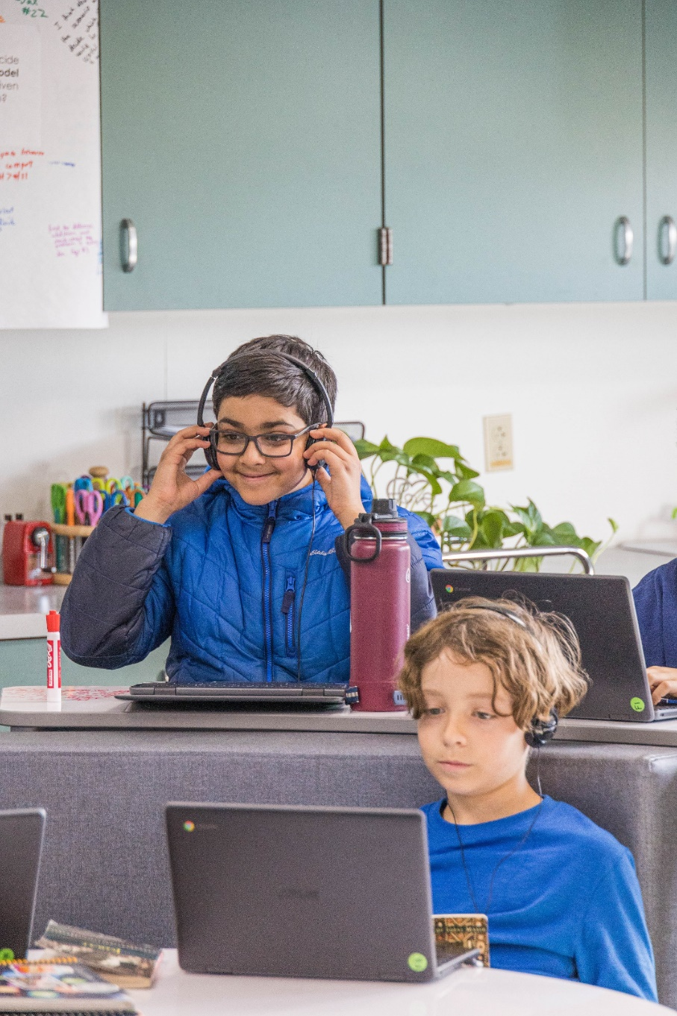
Looking Ahead
Notes:
*Image: Ocean Air Students

Slide 20
Looking Ahead
Enrollment projection and staffing needs
STRS/PERS annual adjustments
  Expected PERS increase
  Potential STRS increase
Social Science & Math curriculum adoptions
Governor’s Proposed Budget
  State revenues continue to be below expectations
  Potential loss of Arts, Music, and Instructional Materials Funds
  Proposition 28 Funds may be less than expected
General economic forecast
  Potential national recession expected late 2023 or early 2024
  Property tax increases expected to slow

Slide 21

Questions?
Notes:
*Image: Torrey Hills Students

